Slide 1
Concept Board

Slide 2
01
Example
01
02
Concept Board is a reference compilation of a product ideas or marketing strategies, accompanied by an illustration

Slide 3
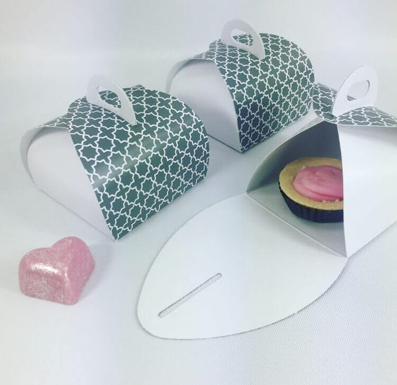
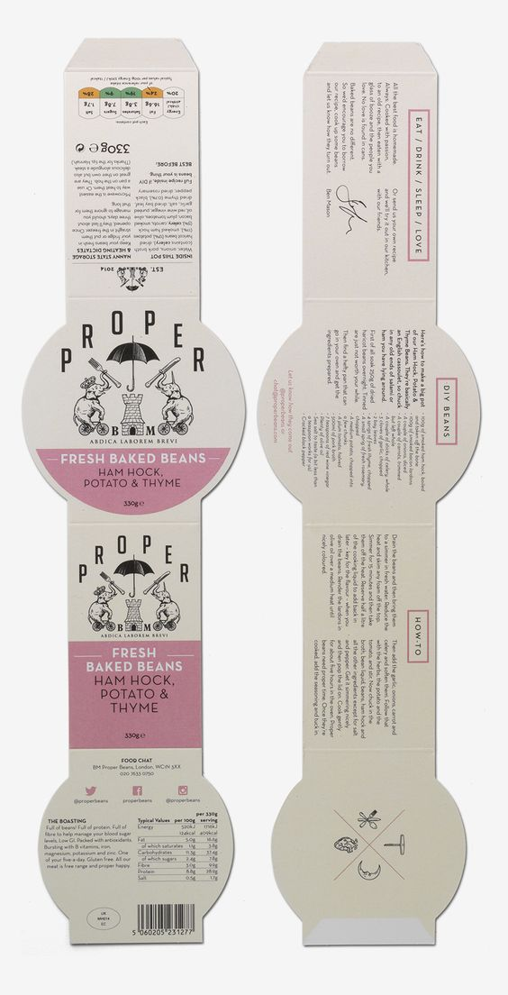

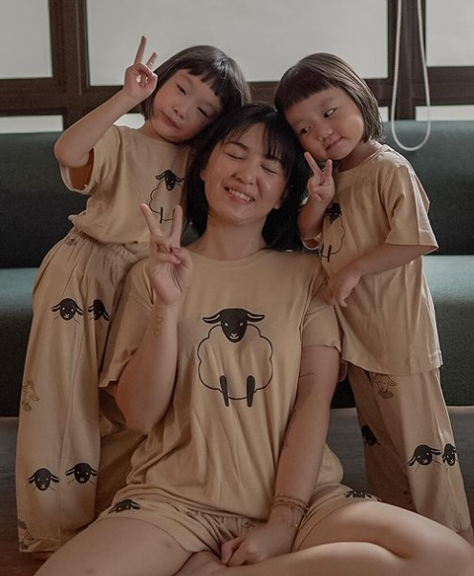

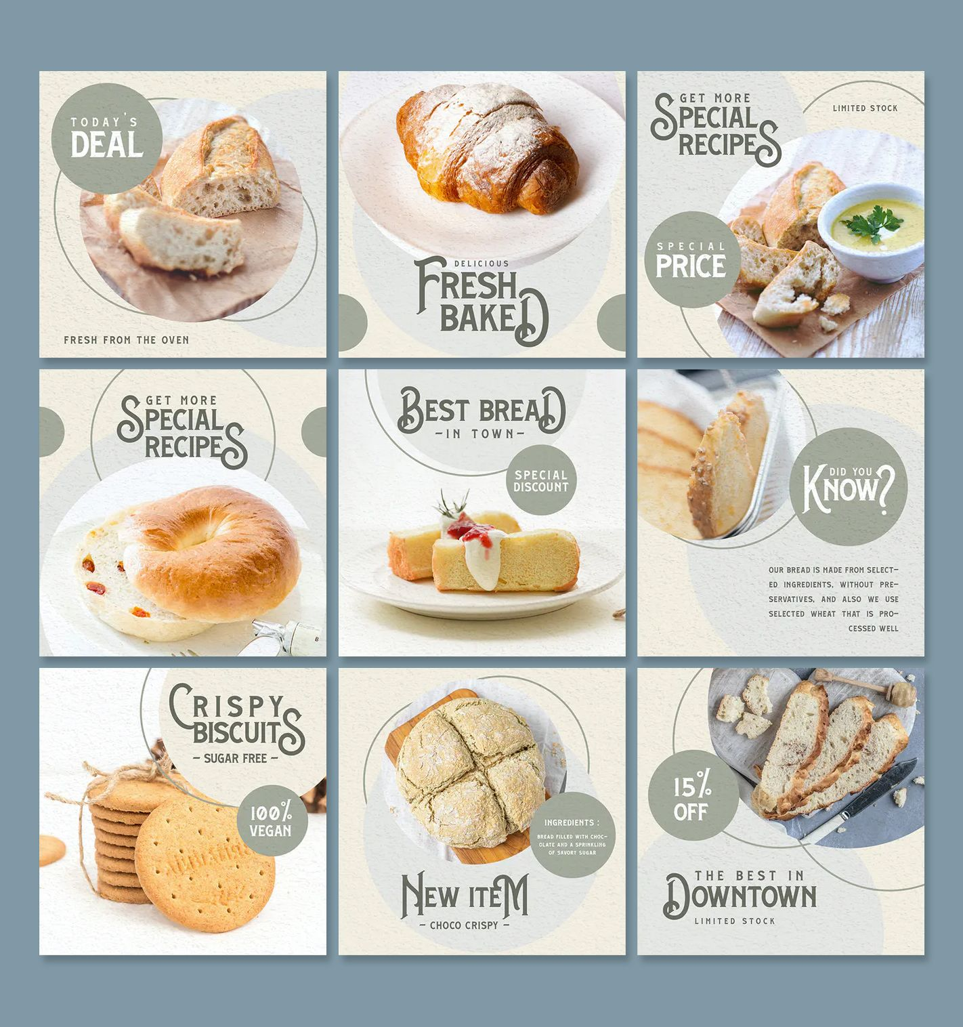
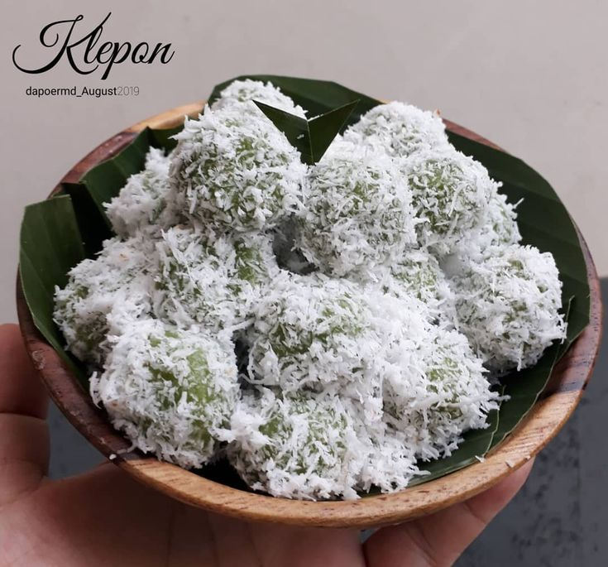
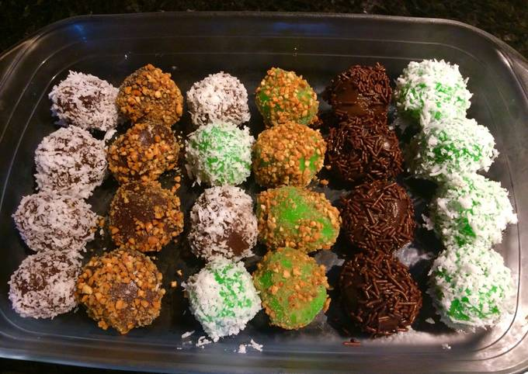
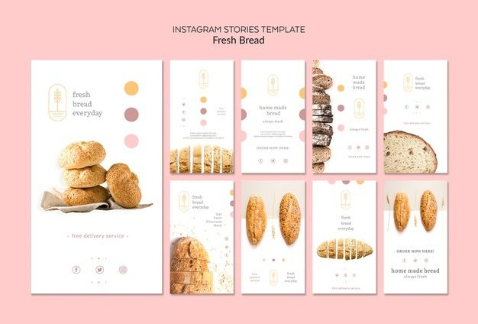
Packaging
KOL
Instagram Post
Products

Slide 4
02
Your Turn!
01
02
Do a mini research! After that, compile all your research of related products using a concept board
Let's Get Started

Slide 5
(Aspects 1)
(Aspects 2)
Insert illustration reference
Insert illustration reference
(Aspects 3)
Insert illustration reference
Insert illustration reference
(Aspects 4)

Slide 6
Yeay you have completed!
01
02
03
04
05
06
Good job!

